Slide 1


Team 24: Pyro Sensor
Bi-Weekly Update 1 Alfonso Wong
Martin Ford
Oscar Hernandez Sponsor: Rhett Guthrie TA: TBA
Notes:
Michelle

Slide 2
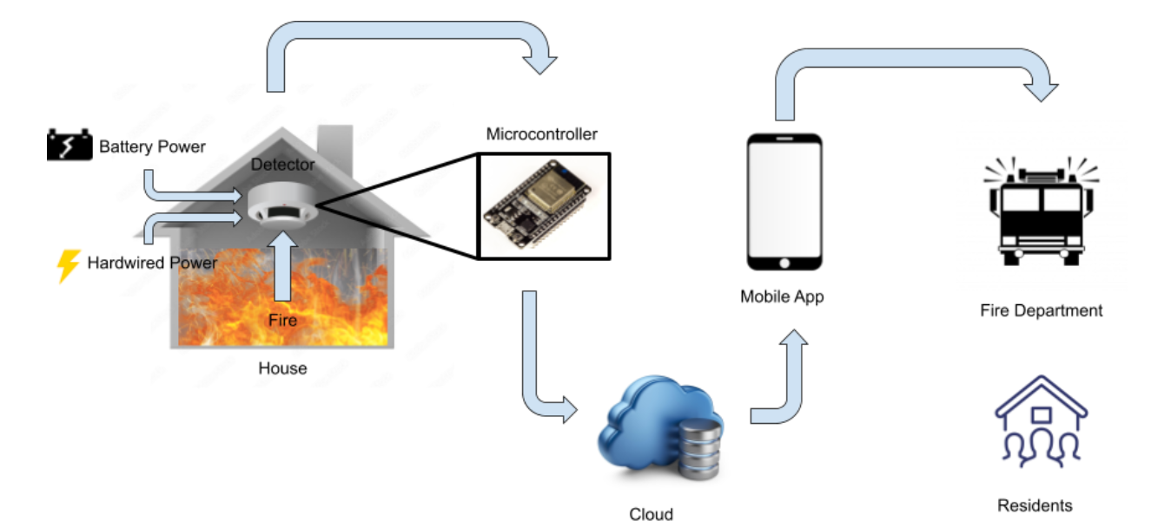
Project Summary
Problem statement:
Modern smoke detectors do not directly notify the emergency responders
Fire department has limited data of residents in buildings
Our Pyro Sensor will:
Notify any user and emergency responders instantly through a mobile app of any incident
Give fire department information about residents and pets
Notes:
Kyle

Slide 3
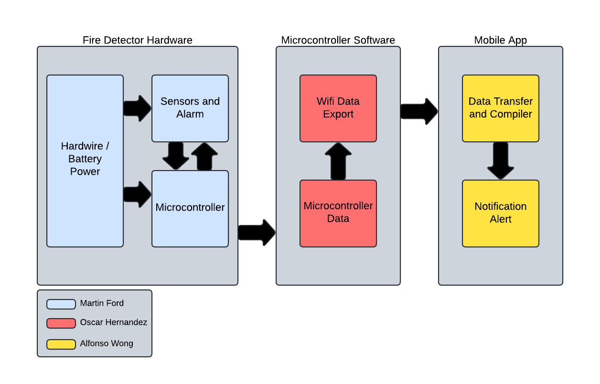
Project/Subsystem Overview
Hardware
Collects sensor data and sends it to microcontroller
MC Software
Gets sensor data, calculates it and sends it to mobile application
Mobile Application
Displays sensor information and will alert users and Fire Department in case of fire alert.
Notes:
Eric

Slide 4
Major Project Changes for 404
Hardware
N/A
MC Software
N/A
Mobile Application
Alerting 911 central dispatcher instead of directly fire department
Notes:
Eric

Slide 5
Project Timeline
 | ECEN 403 | 02/03 | Date
App works in customers side, can create account |  |  | 12/03
workspace, display sensor info, read/write to database |  |  | 12/03
Power is successfully delivered to full PCB |  |  | 12/03
Some sensors work and deliver signals |  |  | 12/03
Microcontroller works continuously, sending data to Firebase |  |  | 12/03
Fix/update notification System, picture upload |  |  | 02/03
Switch communication to centralized dispatcher |  |  | 02/03
Fix PCB schematic mistakes |  |  | 02/03
Reorder and resolder PCB |  |  | 02/03
Ensure all sensor modules are functional |  |  | 02/03
MCUs establish connection per user using app, which displays sensor info and fire status |  |  | 02/03
Notes:
Eric

Slide 6
Hardware Subsystem
Martin Ford
Accomplishments since 403 0 hrs of effort | Ongoing progress/problems and plans until the next presentation
N/A | Fix schematic errors Reorder and resolder PCB Get all sensor modules to deliver signals to the MC

Slide 7
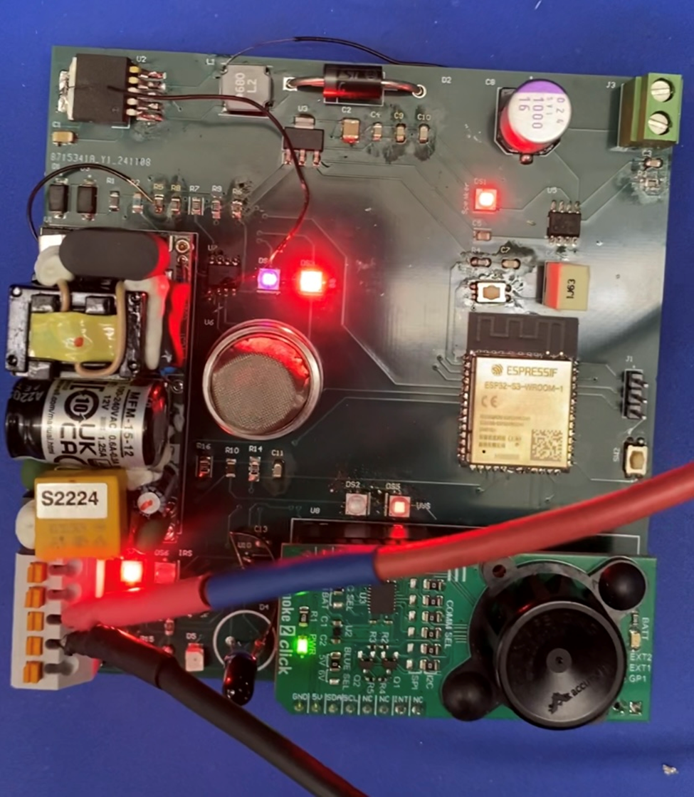
Hardware Subsystem
Martin Ford
What works:
Power distribution to full PCB
Speaker makes sound from signal
IR sensor module delivers signal to microcontroller
What does not work:
Speaker sound needs greater amplification
UV, gas, and photoelectric sensor modules do not consistently deliver signals to microcontroller

Slide 8
Microcontroller Software Subsystem
Oscar Hernandez
Accomplishments since 403 0 hrs of effort | Ongoing progress/problems and plans until the next presentation
Firebase Realtime Database is online, and displaying data from sensors | Develop a method that adds new devices to the mobile app Update the code to account for changes in final PCB (e.g., resistor divider ratios)

Slide 9
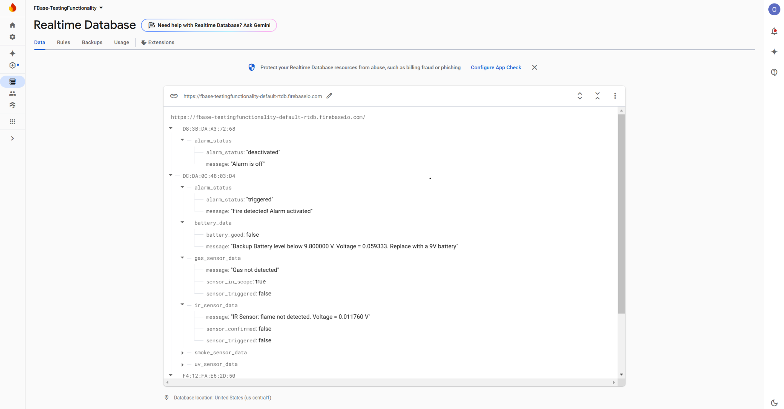
Microcontroller Software Subsystem
Oscar Hernandez
What Works:
Microcontrollers read analog data from sensors and send it to Firebase using ADC
Microcontrollers measure voltage level of backup battery
Microcontrollers activate speaker whenever a fire is detected
What Doesn’t Work:
Smoke sensor powers up, but difficulty in controlling logic of I2C registers

Slide 10
Mobile Application Subsystem
Alfonso Wong
Accomplishments since 403 2 hrs of effort | Ongoing progress/problems and plans until the next presentation
The mobile application is back up and running and able to pull data from the database (Firebase) | Develop the feature of adding a device to the app Change the notification system to 911 dispatcher Fix picture upload to application

Slide 11
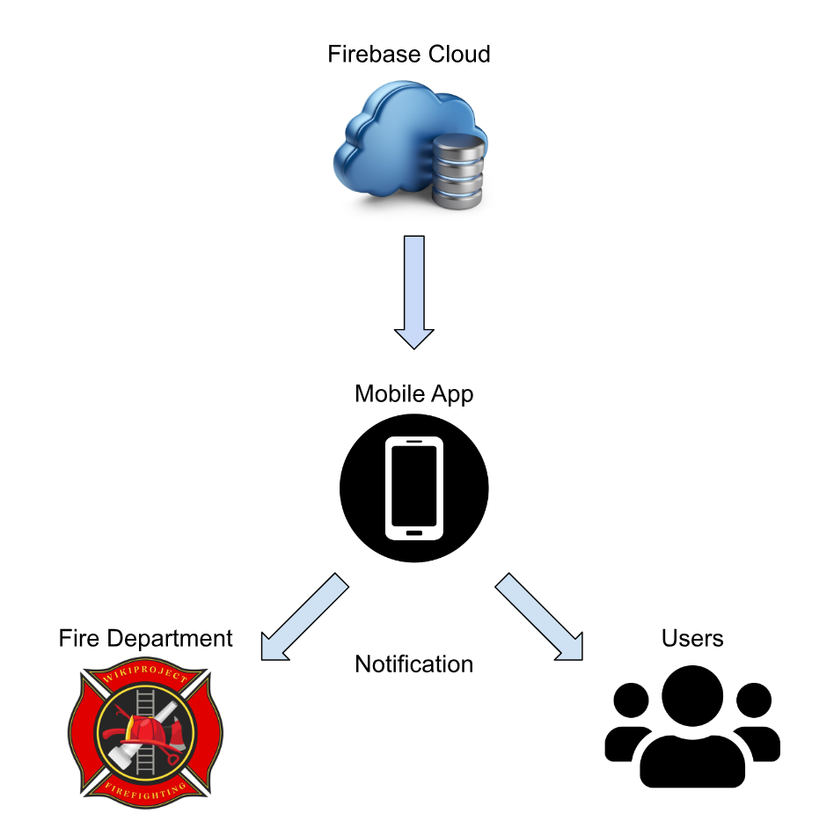
Mobile Application Subsystem
Alfonso Wong
Functioning
User account creation
Gets users information (name, age, address, type of building, expected occupants, etc.)
Database (writing/reading data)
Non-Functioning
Communication to Fire Department/Switch to 911 central dispatcher
Centralized: Central dispatch centers are designed to handle emergency alerts and route them to the appropriate fire department. Central dispatch can reroute alerts if one department is unavailable, minimizing the risk of delays in response time.

Slide 12
Parts Ordering Status
Hardware Subsystem Parts Status
Reorder parts needed or parts not already bought in bulk:
Fixed PCB
Regulator
Buck Converter
AC/DC Converter
Microcontroller and Network Subsystem Parts Status
Order additional MCUs to simulate network nodes as needed
Mobile Application Subsystem
If needed, I will pay for the subscription to APIs. (~$2/month)
Notes:
Michelle

Slide 13
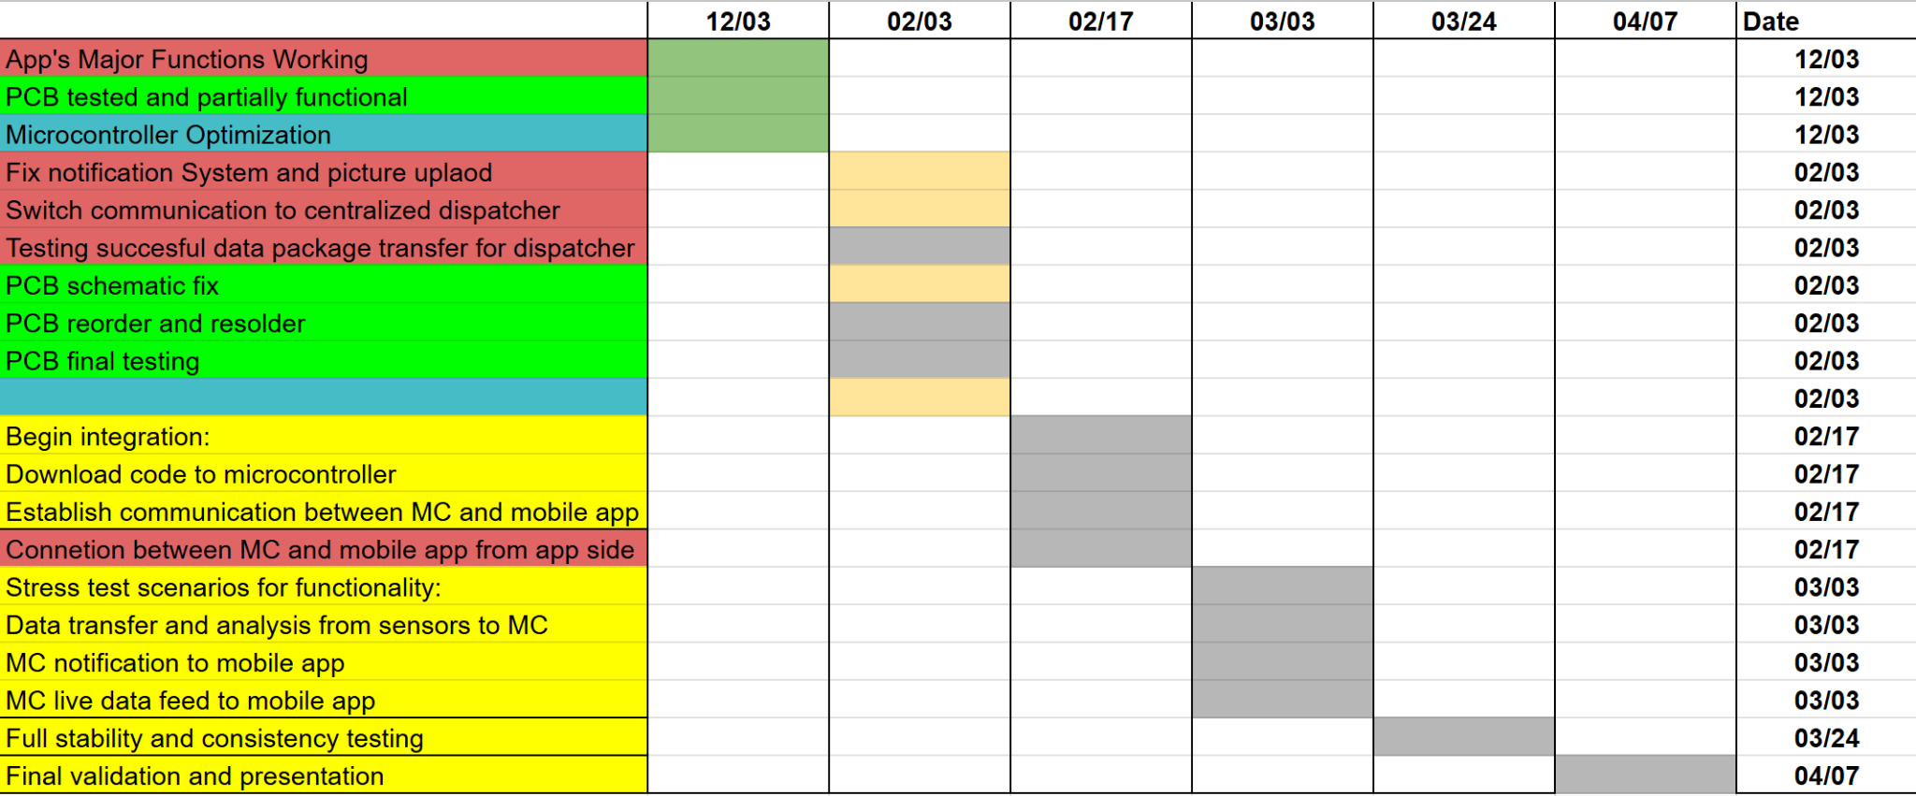
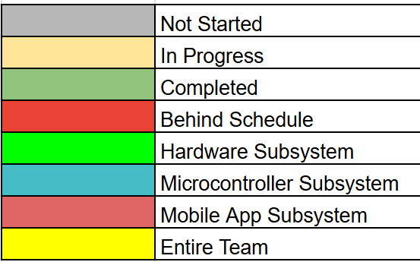
Execution & Plan
Notes:
Michelle

Slide 14
Validation Plan
Test Name | Success Criteria | Status | Responsible Engineers
Sensor Functionality | Sensors detect smoke/flame at expected ranges and output a signal. | Untested | Martin Ford
Speaker Functionality | Speaker emits sound from signal at >80 dB. | Untested | Martin Ford
Operating Time | System operates and receives full power continuously for 1 hour on each power source. | Untested | Martin Ford
Network | MCU is able to aggregate all sensor data to the gateway. | Tested | Oscar Hernandez
Trouble Signal | MCU sends trouble signal to app for malfunctioning node. | Tested | Oscar Hernandez
User Profile Creation | User is able to create an account and be able to sign in. | Tested | Alfonso Wong
Push Notifications | Be able to push notifications to both users and firefighter department. | Untested | Alfonso Wong
Design UI | Have a working UI and test with emulator. | Tested | Alfonso Wong
Integrate Cloud Service | Mobile app has ability to pull data from cloud service and display it. | Tested | Alfonso Wong

Slide 15
Validation Plan
Test Name | Success Criteria | Status | Responsible Engineers
Picture Upload | User can Upload pictures to profile. | Untested | Alfonso Wong
MCU Peripherals Interface | MCU reads signals from all sensors, and activates/deactivates alarm. | Untested | Martin Ford & Oscar Hernandez
Device and Application Communication | Device(sensor) can be added to user profile in application. | Untested | Alfonso Wong & Oscar Hernandez
Real Time Communication | MC is feeding constant information to database and it is being displayed in real time in mobile application. | Untested | Alfonso Wong & Oscar Hernandez
Trigger Warning from MC | MC must send a tigger alert of ongoing event and application must send notification to user and dispatch | Untested | Alfonso Wong & Oscar Hernandez
Early Fire Detection | The system reduces the propagation of a fire by minimizing false alarms and notifying the user or fire department as soon as a fire is detected. | Untested | All

Slide 16
Thank you for your attention!
Questions?

